Slide 1



Display User ID and Roles
m

Slide 2

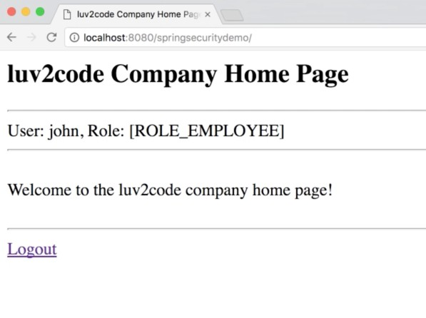
Display User ID and Roles
www.luv2code.com

Slide 3




Display User ID and Roles
User ID
Role
www.luv2code.com

Slide 4
Spring Security
•
Spring Security provides JSP custom tags for accessing user id and roles
www.luv2code.com

Slide 5
Development Process
Step-By-Step
Update POM file for Spring Security JSP Tag Library
Add Spring Security JSP Tag Library to JSP page
Display User ID
Display User Roles
www.luv2code.com

Slide 6



Step 1: Update POM file for Spring Security JSP Tag Library
File: pom.xml
<dependency>
<groupId>org.springframework.security</groupId>
<artifactId>spring-security-taglibs</artifactId>
<version>${springsecurity.version}</version>
</dependency>
Spring Security Taglibs
www.luv2code.com

Slide 7

Step 2: Add Spring Security JSP Tag Library to JSP page
<%@ taglib prefix="security"
uri="http://www.springframework.org/security/tags" %>
www.luv2code.com

Slide 8



Step 3: Display User ID
File: home.jsp
<%@ taglib prefix="security"
uri="http://www.springframework.org/security/tags" %>
…
User: <security:authentication property="principal.username" />
User ID
www.luv2code.com

Slide 9


Step 4: Display User Roles
File: home.jsp
<%@ taglib prefix="security"
uri="http://www.springframework.org/security/tags" %>
…
Role(s): <security:authentication property="principal.authorities" />
User Roles
www.luv2code.com

Slide 10
Restrict Access Based on Roles
m

Slide 11

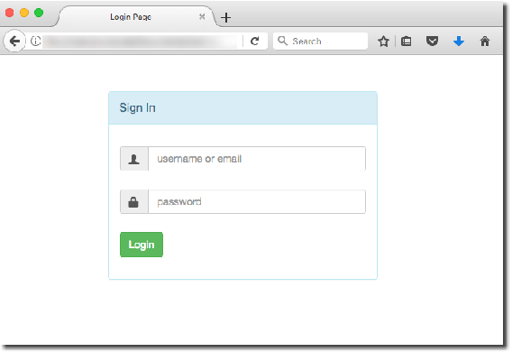


Our Example
/leaders
Leadership Retreat Page
/
role: MANAGER
Home Page
role: EMPLOYEE
/systems
Admin Holiday Cruise
role: ADMIN
www.luv2code.com

Slide 12
Development Process
Step-By-Step
Create supporting controller code and view pages
Update user roles
Restrict Access based on Roles
www.luv2code.com

Slide 13

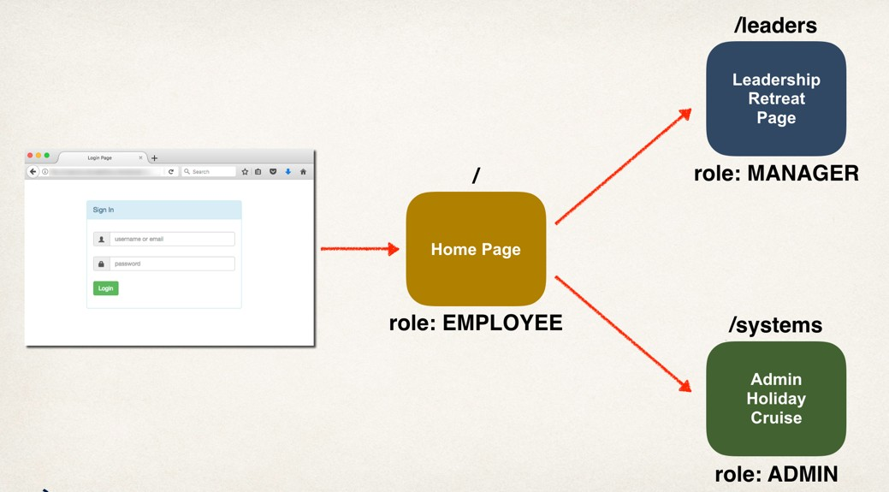

Step 1: Create Supporting Controller code and View Pages
Cover these steps
in the video
www.luv2code.com

Slide 14








Step 2: Update Our User Roles
User ID | Password | Roles
john | test123 | EMPLOYEE
mary | test123 | EMPLOYEE, MANAGER
susan | test123 | EMPLOYEE, ADMIN
We can give ANY names for user roles
www.luv2code.com

Slide 15

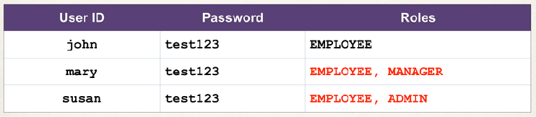


Step 2: Update Our User Roles
File: DemoSecurityConfig.java
@Override
protected void configure(AuthenticationManagerBuilder auth) throws Exception {
// add our users for in memory authentication UserBuilder users = User.withDefaultPasswordEncoder(); auth.inMemoryAuthentication()
.withUser(users.username("john").password("test123").roles("EMPLOYEE"))
.withUser(users.username("mary").password("test123").roles("EMPLOYEE", "MANAGER"))
.withUser(users.username("susan").password("test123").roles("EMPLOYEE", "ADMIN"));
}
www.luv2code.com

Slide 16






Step 3: Restricting Access to Roles
Update your Spring Security Java configuration file (.java)
General Syntax
Single role
antMatchers(<< add path to match on >>).hasRole(<< authorized role >>)
Restrict access to a given path “/systems/**”
“ADMIN”
www.luv2code.com

Slide 17




Step 3: Restricting Access to Roles
Any role in the list, comma-delimited list
antMatchers(<< add path to match on >>).hasAnyRole(<< list of authorized roles >>)
“ADMIN”, “DEVELOPER”, “VIP”, “PLATINUM”
www.luv2code.com

Slide 18




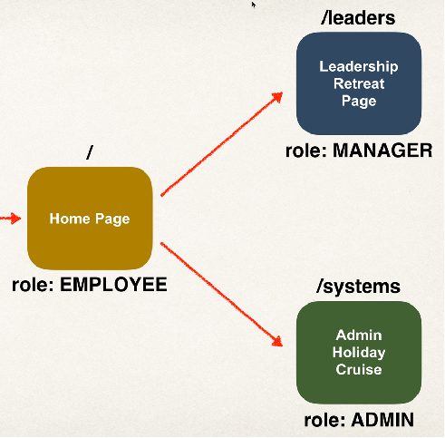
Restrict Path to EMPLOYEE
antMatchers("/").hasRole("EMPLOYEE")
Match on root path: /
www.luv2code.com

Slide 19



Restrict Path /leaders to MANAGER
antMatchers("/leaders/**").hasRole("MANAGER")
Match on path: /leaders And all sub-directories (**)
www.luv2code.com

Slide 20

Restrict Path /systems to ADMIN
antMatchers("/systems/**").hasRole("ADMIN")
Match on path: /systems And all sub-directories (**)
www.luv2code.com

Slide 21




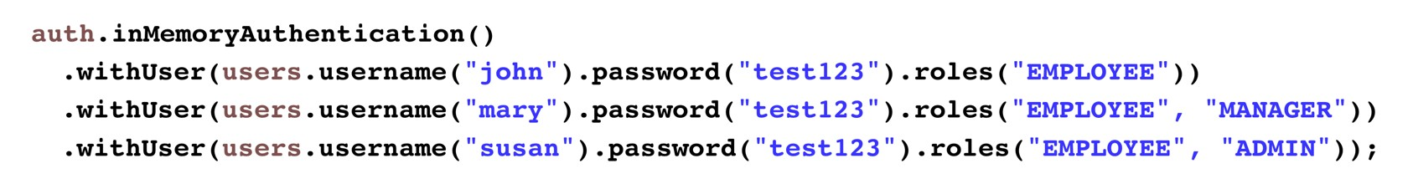
Pull It Together
@Override
protected void configure(HttpSecurity http) throws Exception {
http.authorizeRequests()
.antMatchers("/").hasRole("EMPLOYEE")
.antMatchers("/leaders/**").hasRole("MANAGER")
.antMatchers("/systems/**").hasRole("ADMIN")
.and()
.formLogin()
…
}
www.luv2code.com

